Slide 1

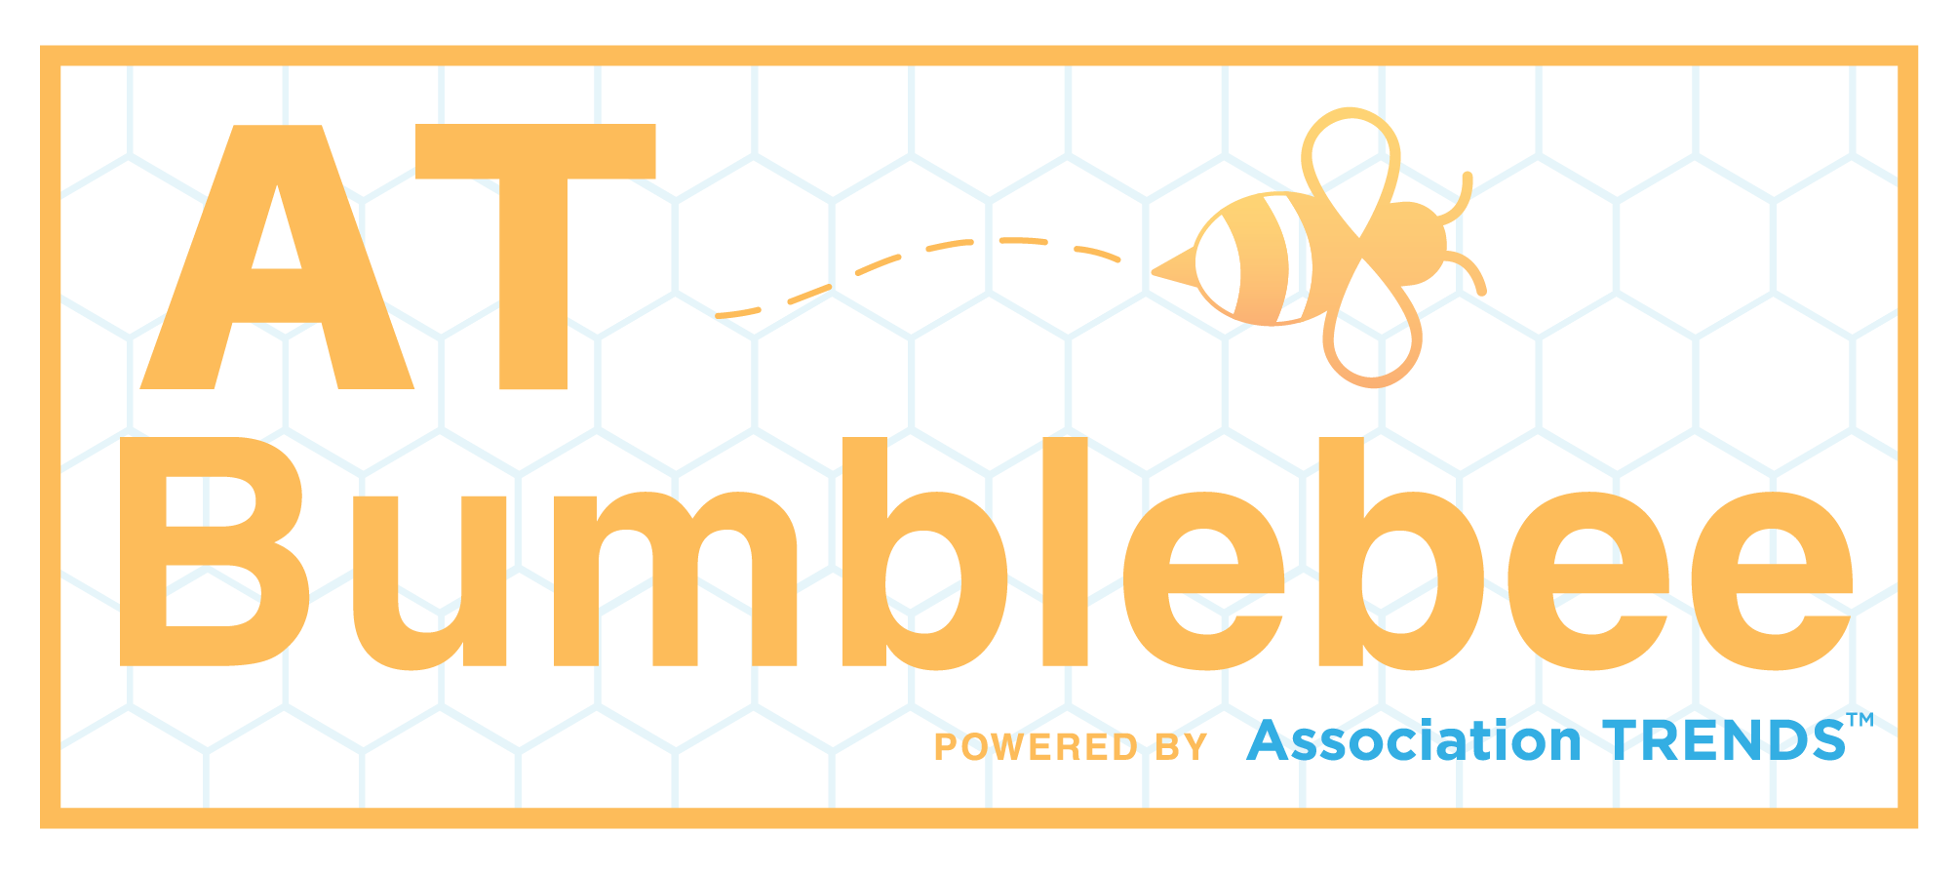
If You Want Something (Huge) Done Right, Let a Machine Do It
How ISPE Leveraged Advanced Data Matching Algorithms to Develop Master Organizational Data
Duncan Bell, Bumblebee
David Everett, ISPE

Slide 2
Introductions
Duncan Bell
Lead Developer & Architect, Bumblebee
Heads data services team for Association TRENDS. Passionate about the potential of data and the power of automation.
David Everett
Senior Director of IT, ISPE
Responsible for systems, integration, infrastructure and - as of 2020 - data and business intelligence

Slide 3
Agenda
ISPE’s Company Data Dilemma
Crash Course in Automated Data Matching
Developing the Solution
Questions

Slide 4
About ISPE
ISPE is the International Society for Pharmaceutical Engineering
Founded in 1980 with the goal of advancing technical efficiency of our members through conferences, training sessions and industry guidance.
Our goal is to maintain leadership in pharmaceutical knowledge in order to deliver innovation in
Supply chain and Operational innovation
Regulatory insight
Delivery of quality medicines to patients
We have about 17,000 members worldwide

Slide 5
ISPE’s Company Data Dilemma
Company data has gotten out of control
Data integrity wasn’t well thought out when the ability to join online was created several years ago
Due to nature of large companies, duplicate companies were entered
Location, department or division were the only distinguishing data points
Our memberships are individual, so some company addresses were actually home addresses
The same company typed differently
Reporting on members from a specific company has become very difficult
Company engagement data has become a more important KPI as membership needs have evolved
Mergers and acquisitions have also made this more difficult

Slide 6
Assessing the Problem
ISPE has a large database (> 100k records) that lacks consistent use of unique identifiers for its company entities
Individual records have manually-entered text fields with company names sans any associated identifier
To make matters worse, there is a ton of duplication
We need to develop master data!

Slide 7
What is Master Data?
A set of data containing the most valuable, agreed upon information shared across an organization
Customers, prospects, products, transactions, etc.
A “single version of the truth”
Your “database of record”

Slide 8
The Need for Master Data
Main
Database
External Source

Slide 9
The Need for Master Data
Main
Database
External Source

Slide 10
The Need for Master Data
Main
Database
External Source

Slide 11
The Need for Master Data
Main
Database
External Source

Slide 12
The Need for Master Data
Single version of the truth → clear, useful analytics
Improved operational efficiency
…But how can we achieve it with a database so HUGE?
Manual data matching is time consuming and tedious
Can we train a machine to do this work for us?

Slide 13
Introduction to Bumblebee
Automated data hygiene solution written in python
Optimized for AMS datasets; platform agnostic
Scales well with large datasets
Addresses data standardization, quality, and validation
AND – it entails a powerful data matching/deduplication algorithm
This is what ISPE needs

Slide 14
Automated Data Matching
Map columns
with identifying
information
Pre-processing:
Make data
more machineable
Tokenize:
Split values
into words
Names
Addresses
Phones
Emails
Websites
Etc.
Clean:
NULLs
Punctuation
Standardize:
lowercase
Abbreviations
Acronyms
Derive:
Nicknames
Gender
Domain
tokenize
the
values
into
words
like
this

Slide 15
Tokenizing Example
Example Company
AbbVie, Inc.
1401 Sheridan Rd
North Chicago
IL
60064-1803
USA
abbvie.com
Tokens used for matching
abbvie
1401
sheridan
chicago
IL
60064
1803
Ignored tokens
inc
rd
north
usa
com

Slide 16
Automated Data Matching
Map columns
with identifying
information
Pre-processing:
Make data
more machineable
Tokenize:
Split values
into words
Distill to
match
candidates
Assess
match
candidates
Predict
matches
Group
matches
Names
Addresses
Phones
Emails
Websites
Etc.
Clean:
NULLs
Punctuation
Standardize:
lowercase
Abbreviations
Acronyms
Derive:
Nicknames
Gender
Domain
tokenize
Fuzzy similarity
Cluster
the
ANY two records sharing a minimum threshold of the same words are match candidates
Scored features given to trained model
record
Name uniqueness
values
pairs
into
Email
into
Address
words
groups
Phone
like
Domain
of
this
Disqualifiers
matches

Slide 17
Getting the Lay of the Land
ISPE Database

Slide 18
Getting the Lay of the Land
Records with CO_ID
ISPE Database

Slide 19
Getting the Lay of the Land
Records with CO_ID
ISPE Database
Records without CO_ID

Slide 20
The Plan of Attack
Deduplicate CO_IDs to distill to truly unique
Match deduplicated CO_IDs to records without any assigned CO_ID
Deduplicate/group remaining unmatched records without CO_ID
These can be translated into NEW CO_IDs
Assign “master” company name for each group based on name frequency

Slide 21
Initial Results

Slide 22
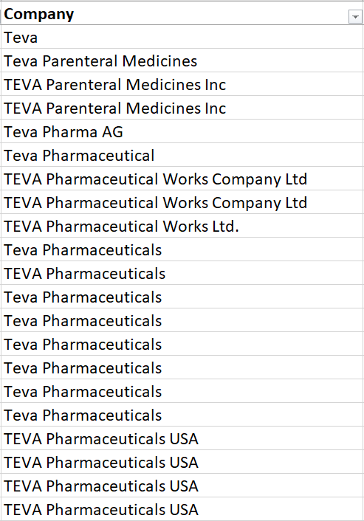
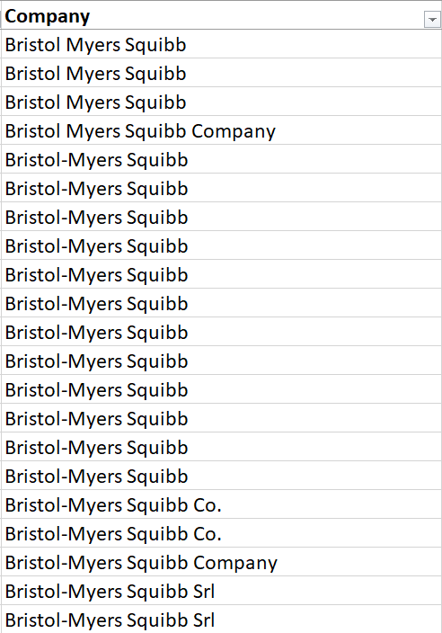
We Have a Problem

Slide 23
We Have a Problem
Matching algorithm discourages too many groups from being merged to protect against improper merges
ISPE’s data contains A LOT of duplicates
This means that the data matcher yields duplicate groups which really should be consolidated

Slide 24
The Solution
Repeat as needed
Map columns
with identifying
information
Pre-processing:
Make data
more machineable
Tokenize:
Split values
into words
Distill to
match
candidates
Assess
match
candidates
Isolate
queens
Predict
matches
Group
matches
Names
Addresses
Phones
Emails
Websites
Etc.
Clean:
NULLs
Punctuation
Standardize:
lowercase
Abbreviations
Acronyms
Derive:
Nicknames
Gender
Domain
tokenize
Fuzzy similarity
Cluster
Match
the
ANY two records sharing a minimum threshold of the same words are match candidates
Scored features given to trained model
record
Name uniqueness
values
pairs
group
into
Email
into
Address
words
groups
queens
Phone
like
Domain
of
this
Disqualifiers
matches
again

Slide 25
The Solution
Round 1
ISPE Database

Slide 26
The Solution
Round 1
Round 2
Round 3
ISPE Database

Slide 27
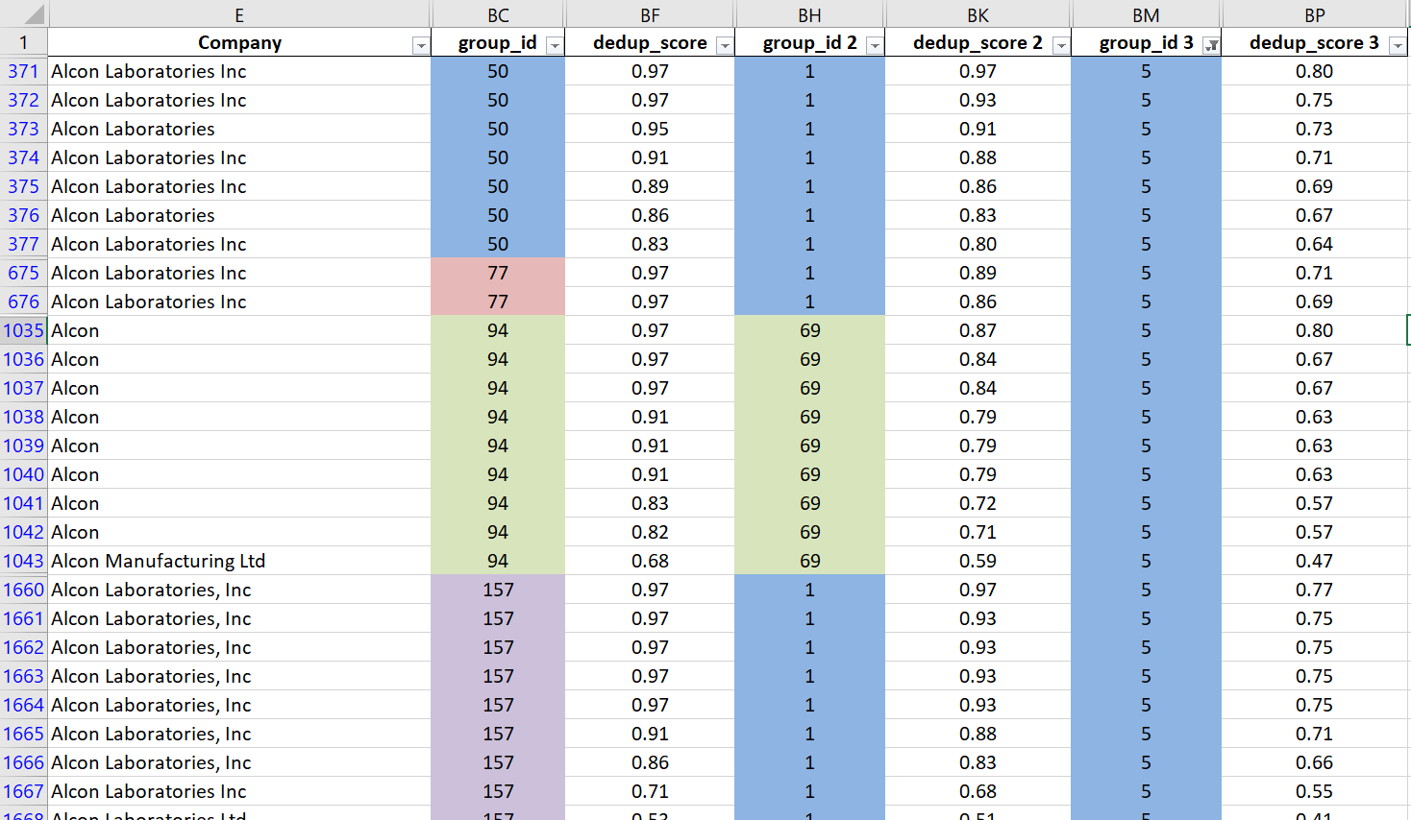

Slide 28
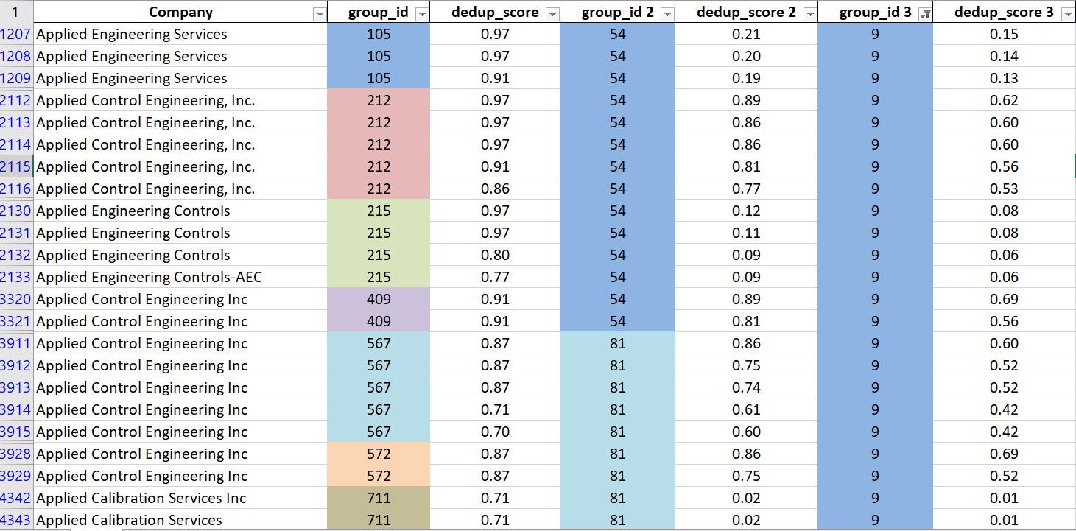

Slide 29
Closing Thoughts
Automated data matching is the only feasible solution to address this type of entity reconciliation for large databases
At the same time – it isn’t magic! Data owners still need to be involved to reconcile edge cases
This approach is useful to address ANY severely duplicated dataset, including people data, two large data silos, etc.

Slide 30
Questions
Contact information:
Duncan Bell, Bumblebee
dbell@columbiabooks.com
240-235-0269
David Everett, ISPE
deverett@ISPE.org
813-739-2279

